Slide 1
Fuelmart & subway
Safety Committee Meeting
9.23.20

Slide 2
August Review
Report any spills over a gallon. Take photos before and after clean up.
THANK YOU!!!
Fm 645, fm 787, & fm 783
New hire training.

Slide 3
2020 Incident Totals:
Company Total: 149
FuelMart & Subway Total: 99
Employee Injuries: 17
Property Damage and/or vehicle incidents: 28
Customer Spills: 35 (24 at fuel pumps)
Customer Injuries: 17
“Other” Incidents: 2

Slide 4
Incidents 8.19.20 – 9.23.20
Minor spills reported:
8.19.20 FM 787
Customer entered store to buy coffee leaving pump unattended. Minor spill. Customer reported and assisted FM employee with clean-up.
8.22.20 FM 783
Pump 6, nozzle separated from the hose.
9.17.20 FM 764
Semi in the truck parking area; saddle tank found to be leaking. Customer clean-up.
9.18.20 FM 767
Musicks called out to blow the vent lines out after a delivery driver reported diesel spray out of the far-right diesel vent tube.

Slide 5
Incidents Continued:
Property Damage:
8.25.20 FM 783
Semi driver went over curb striking mailbox.
9.03.20 FM 783
Customer reported damaged bollard by diesel pump 15.
9.21.20 FM 714
Both bollards at the end of the diesel island struck by passenger side of a semi trailer.

Slide 6
Incidents Continued:
Customer Injuries:
8.20.20 FM 782
Customer passed out after entering store. 911 called. Narcan administered.
8.20.20 FM 626
Customer trying to herd feral cats, scratched. Supplied her with first aid supplies. Refused to provide her information. Refused medical attention.
8.25.20 FM 641
Customer reported he fell in the shower. Claims the floor is too slippery. Medical attention refused.
9.03.20 FM 787
Customer reported she had stubbed her toe and fell. Wanted the incident documented. Struck her chin, hand, knee. Refused medical attention.

Slide 7
Incidents Continued:
Employee Injuries
8.19.20 FM 787
Wrist sprain/bruising (diesel pump 18 island)
9.16.20 FM 787
Chester’s employee, minor burn due to grease splatter when dropping a batch of tenders.
9.23.20 FM 783
Employee slipped/fell. Possible broken toes. Refused medical treatment.

Slide 8
September Topic: Emergency Evacuation Drills
Proper Emergency Evacuation Procedures
Activate the nearest fire alarm (if installed and if the emergency is a fire). If an alarm is not available or the emergency is something other than a fire, notify employees, vendors, and customers of the emergency using an intercom, voice communication or cell phone.
Upon notification of the emergency, all occupants must leave the building using the safest escape route. Be prepared to escape under toxic smoke if necessary.
Certain employees may be required to quickly walk around the building, checking bathrooms, offices, etc. for other individuals still inside.
Help any physically challenged individuals to safety.
Close doors on your way out to give yourself and others more time to safely escape.
Assemble in the designated meeting location.

Slide 9
Proper Emergency Evacuation Procedures Continued
7. Notify emergency personnel by calling 911 (from outside the building).
8. Take a head count after the evacuation. Identify the employee names, vendors, and number of customers, along with the last known locations of anyone not accounted for, and pass them to the official in charge. You may need to communicate between the two meeting locations.
9. Be prepared to evacuate further in case the incident expands. In this case, keep the group together.
10. Notify Joel Teague via cell phone call.
11. Remain outside until the competent authority announce that it is safe to re-enter. Never return to the facility once you are outside without an all clear.

Slide 10
In the case of a tornado where you may have to seek inside shelter:
Notify all individuals that a tornado is in the area and you will need to seek shelter in your facility’s designated location.
Stay away from outside walls and windows.
Use your arms to protect your head and neck.
Remain sheltered until the tornado threat is announced to be over.
Notify Joel Teague via cell phone call.

Slide 11
Conducting and Documenting Evacuation Drills
In this evacuation drill, employees will “walk and talk through” the actions needed to safely evacuate.
Evaluator Pre-Planning Procedures:
Ensure you are comfortable and knowledgeable of the steps that each individual employee needs to perform.
Be able to introduce the drill and explain what the employees can expect and what is expected of them. The goal of the drill is to prepare for an evacuation of the facility, and in the process, review and improve our evacuation processes.
Explain how the drill will work and provide the scenario (fire, gas leak, tornado, etc.). Be detailed and give the employees the location and a description of what happened. For example, an electrical outlet has caught fire in the hallway near the Men’s Restroom.

Slide 12
Conducting the Drill:
Notify employee(s) that at some point during their shift, they will be asked to perform an evacuation drill and explain the procedures above.
Note the time of the drill on the form and tell the employee(s) to evacuate.
Observe the employee(s) response

Slide 13
Observation may include:
Did the employee call 911?
Does the employee know to shut down pumps?
Did the employee complete a quick walk around (i.e. bathrooms), inform customers to evacuate, activate the fire alarm if present (Note: do not actually activate), and assist any physically challenged individuals?
Did the employee use the safest exit route based on where the fire or gas leak is located?
Did the employee close the door behind him/her?
Did the employee go to the meeting location? Does the employee know both meeting locations?
Does the employee know to do a headcount?
Does the employee know to call manager, Joel, Haley, etc. after getting outside?
Does the employee know not to re-enter the building under any circumstances?
Does the employee know to evacuate further if necessary?

Slide 14
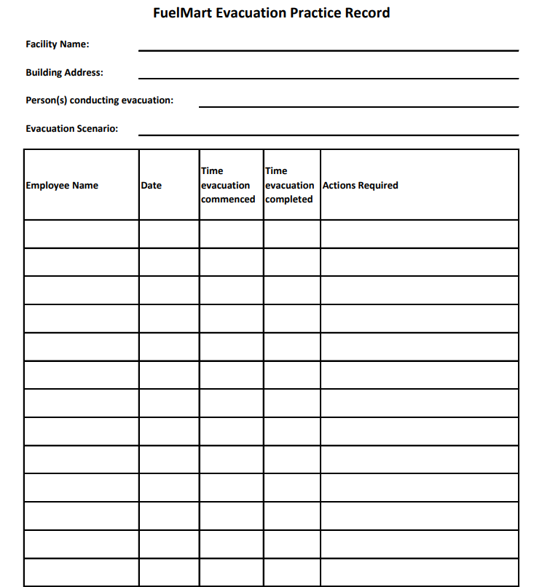
Complete the Fire Evacuation Practice Record.

Slide 15
Comments? Questions? Suggestions? Call me! I love hearing from you!
Next Meeting: October 21,2020

